Slide 1
PG MANAGEMENT SYSTEM
RDBMS PROJECT
PRESENTED BY:
Krishi Agarwal 2141119
Aaryaki Pandey 2141143
Riya Mary Cleetus 2141158
(4BCA-B)

Slide 2
PG MANAGEMENT SYSTEM!
When we think of PG Management System, two questions arise
WHAT?
WHY?

Slide 3
WHAT IS PG MANAGEMENT SYSTEM?
This website aims to give a complete package to a PG(paying guest), leading to the complete digitalization of the organization. Be it the attendance of the student, rent of the room, ordering ingredients for the kitchen, the salary of employees, or room cleaning services, it makes the working of a PG a lot easier by bringing everything together in a student-friendly manner.

Slide 4
WHY PG MANAGEMENT SYSTEM?
AN ANSWER TO THE QUESTION, “WHY DO WE USE TECHNOLOGY?” IS A DIRECT ANSWER TO THIS AS WELL.
PG management system eases the work of the owner, the manager, and the wardens, and provides a sense of security to the parents about their kids. It helps the students keep track of their activities in the PG and records their time spent in the PG through the attendance feature. One of the major features of this application is a forum where the students and parents can express their grievances and issue complaints, which are then looked into by the manager or the wardens of the specified unit.

Slide 5
PROBLEM WITH THE EXISTING SYSTEM
The existing system is based on manual work and all the processes are done manually, so they maintain registers and files for recording all the details of the system.
They maintain several registers for recording the entry of daily transactions such as visitors visiting the hostel, visitor drop messages for a particular student, etc.
They maintain the record of the students so they keep each and every piece of information regarding the students in the student master file. In a similar fashion, they maintain the records of their fees so they keep each and every piece of information regarding their fees details in the fees master file.
They keep the bill Book or receipt Book to maintain the record of the fees collected by the student.
They maintain the register or Book for staff so they can pay the salary.
Thus maintaining Staff information, Student Information, Visitors information, Check-in and Checkout information, and all the things are done manually.

Slide 6
HOW IS PG MANAGEMENT SYSTEM DIFFERENT FROM OTHER WEBSITES?
There might be some websites about PG managing including taking care of the rent and attendance, but this application completely digitalizes the working of the Paying Guest service.
Thus to bring it in,
“WE ARE CLUBBING ALL THE FEATURES OF WEBSITES WHICH ARE PRESENT IN THE MARKET AND, ALONG WITH THEM, MANY EXCLUSIVE FEATURES WHICH HAVE YET TO BE DIGITALIZED”

Slide 7
MAIN MODULES:
RENT
ATTENDANCE
SALARY
CLEANING
ORDER
ROOMS
GALLERY
FEEDBACKS
EMPLOYEES
PROFILE

Slide 8
VARIOUS USERS ARE:
OWNER
MANAGER
WARDEN
STUDENT
PARENT
COOKS
CLEANERS

Slide 9
USER 1: OWNER
The owner has access to all the details of each unit including the managers, wardens, and employees that have been assigned to each unit.
The owner of the PG has the ability to add and remove users in the application, including managers, wardens, cooking and cleaning heads, students, parents, etc.
The owner takes care of the salary of each employee and oversees the working of the employees.
The owner also addresses the grievances of the students or parents in case the wardens or managers fail to do it.

Slide 10
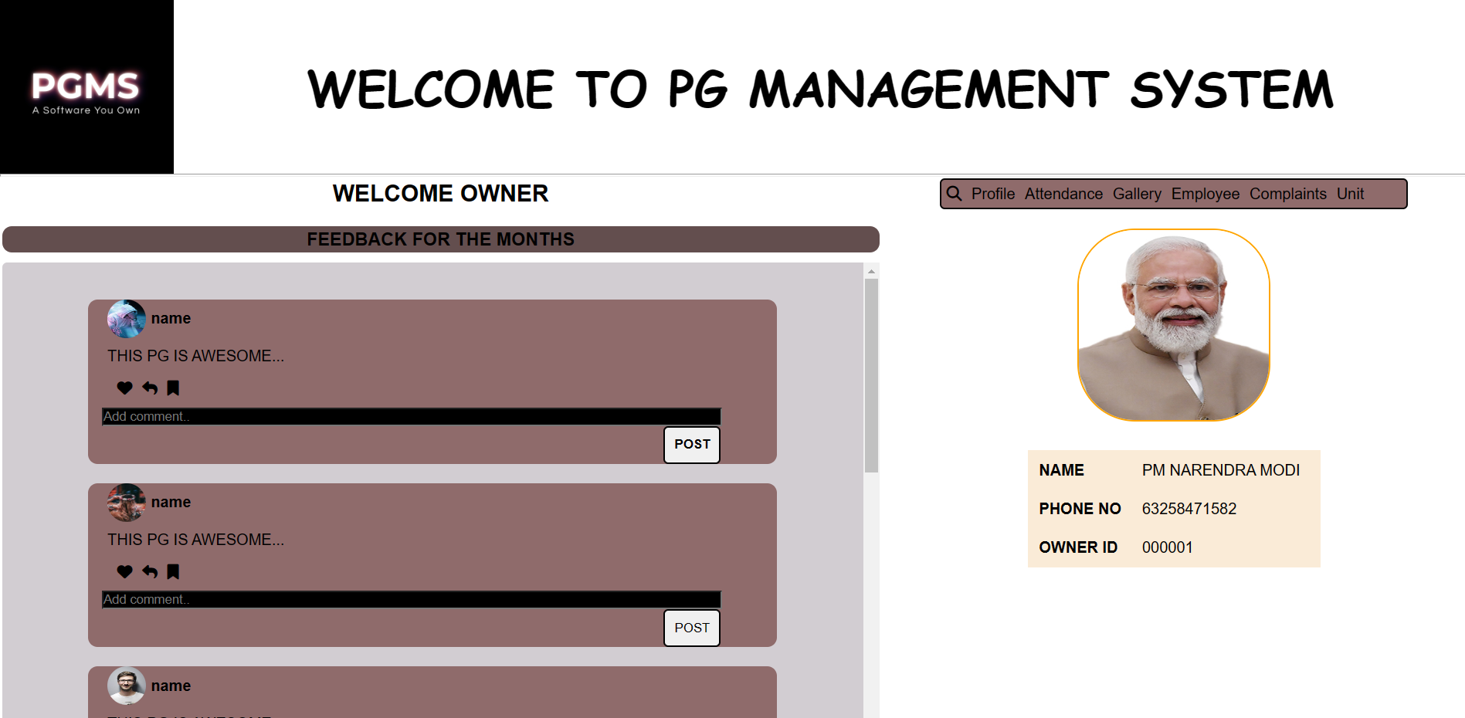
SAMPLE WEB PAGE:

Slide 11
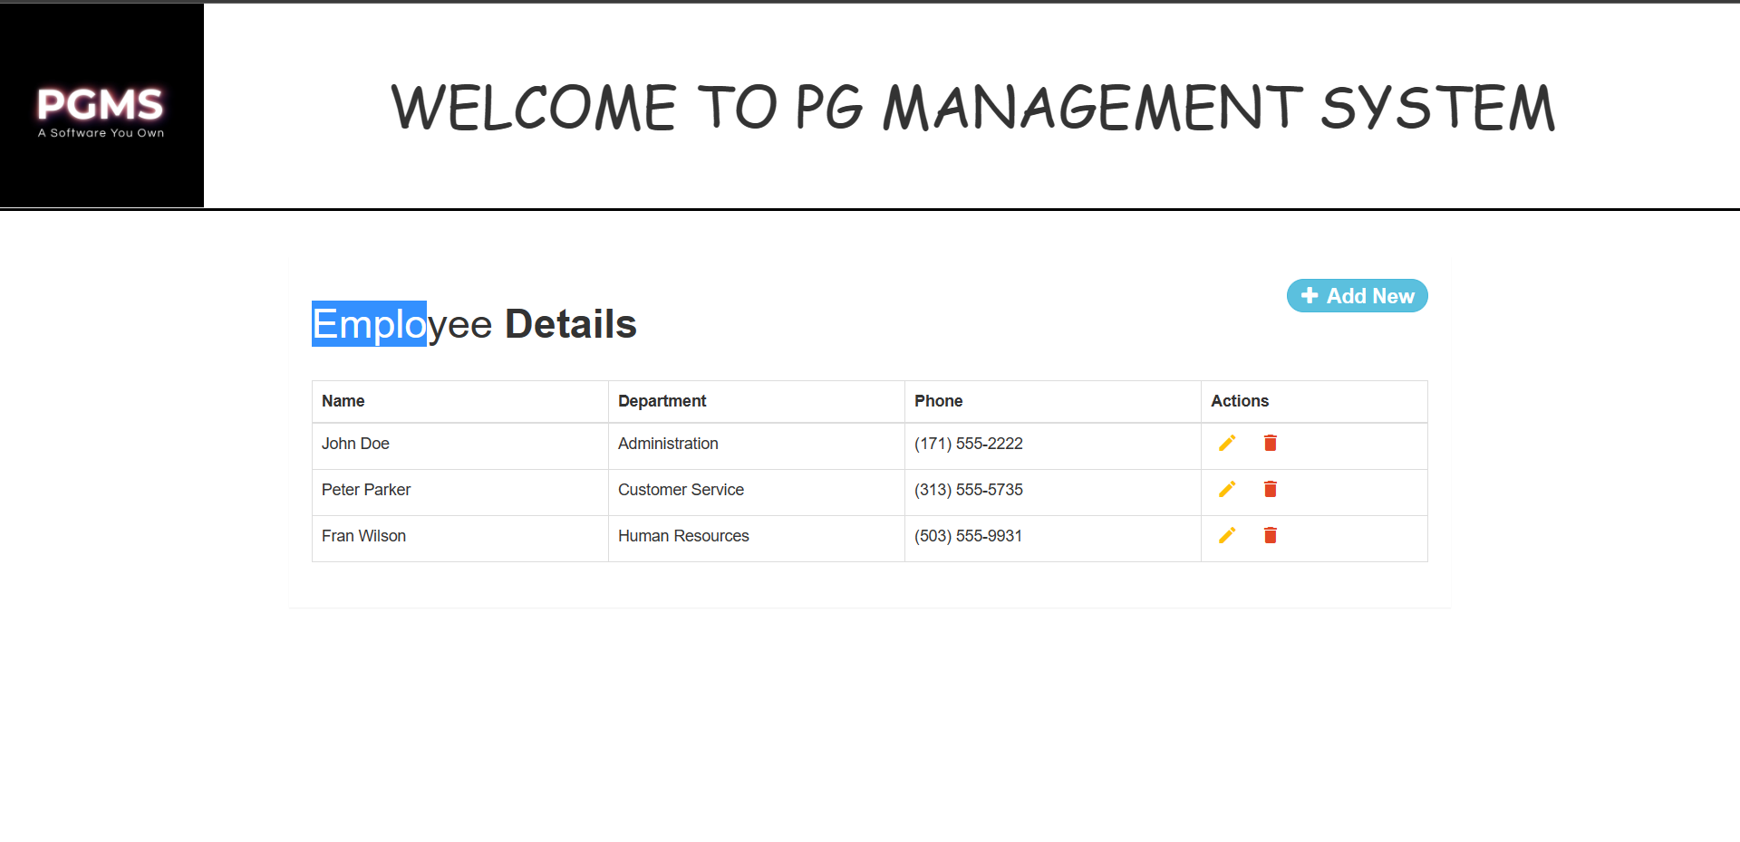
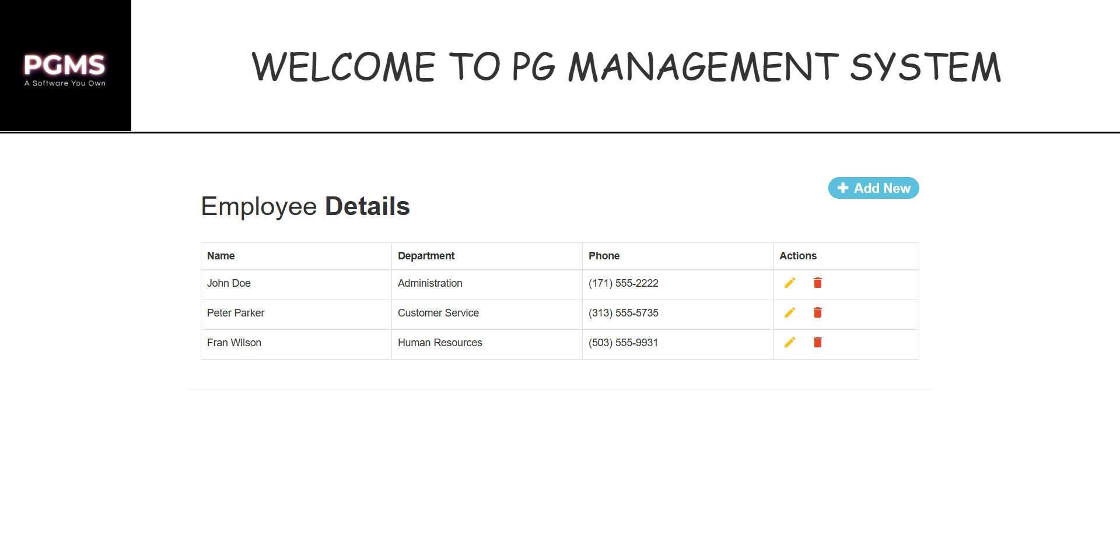
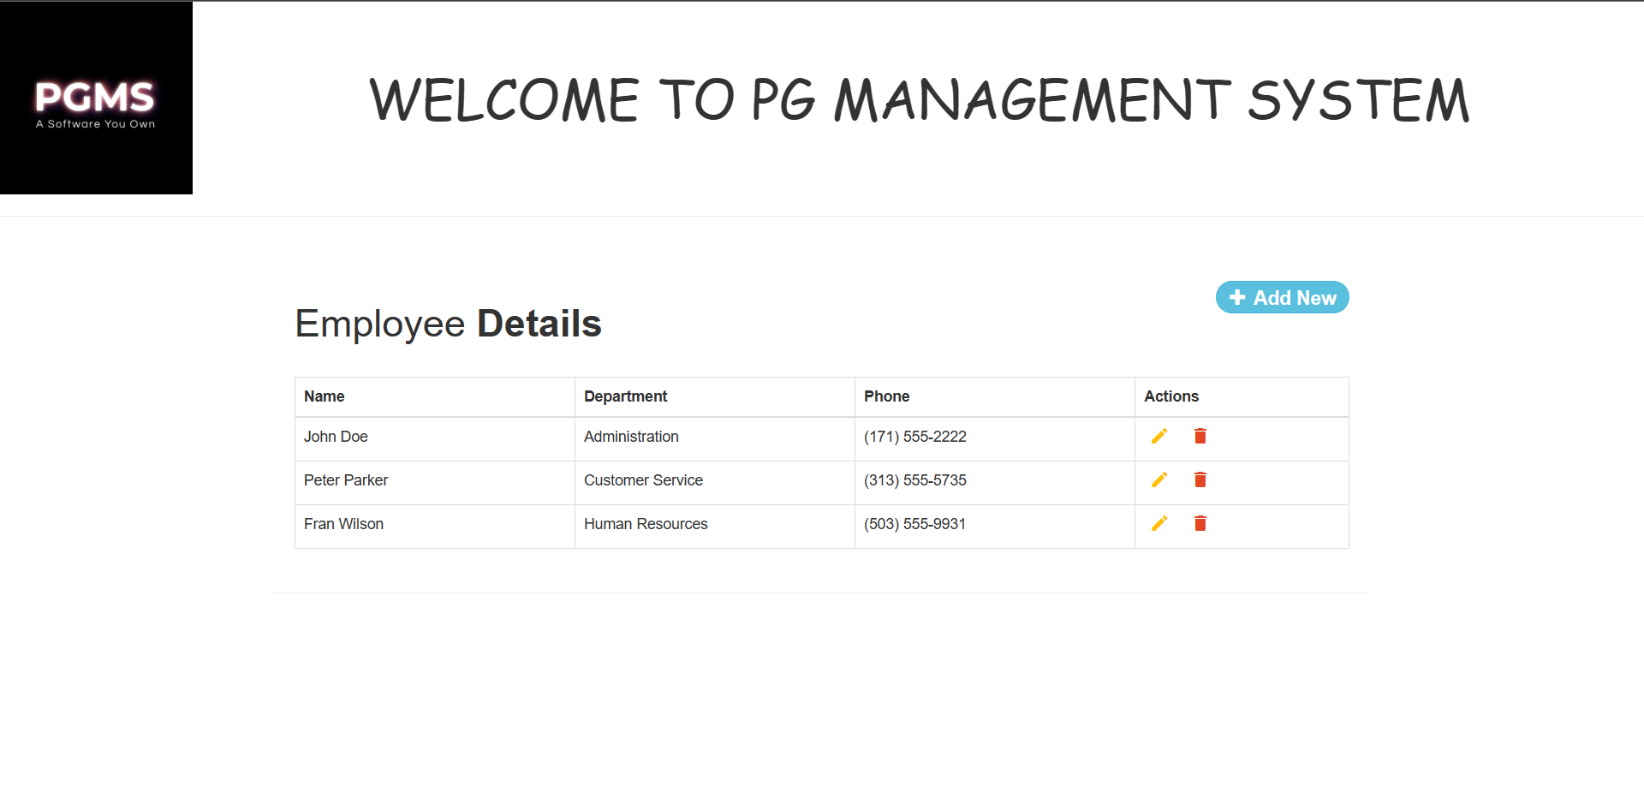

Slide 12
USER 2: MANAGER
The manager of each unit has access to all the inquiries about that specific unit that only they can respond to. The inquiries that people post about the PG come directly to the manager’s page which in turn they respond to.
The managers have access to the rent status of the students and only they can update it. They check whether the rent has been paid by the students and notify the warden if a reminder has to be sent.
The occupancy status of each room, be it fully or partially, and details of the old/current residents of each room are managed and accessed by the manager of the unit.
The manager receives requests for the ingredients from the cook-head according to the menu and makes sure the kitchen is stocked.
Managers also have access to the attendance of all employees and their salary payment details.

Slide 13
USER 3: WARDEN
Each unit of the PG has a day warden and a night warden.
The wardens are supposed to keep track of the in and out times of the students, by taking attendance through the app, which is then reflected in the student profile.
Past curfew time, the wardens have to notify the parents about the presence or absence of their children.
Wardens keep track of the rent paid and remind the students if they are past the due date.
Wardens address the grievances and concerns issued by the students and take appropriate measures to look into the same.
Overall, wardens are a communication link between the students and parents and give parents updates about their kids, as well as take care of the residents of the PG and address their complaints and issues.

Slide 14
USER 4: STUDENT
Each student has their own profile with a unique ID which distinguishes them from other students in the same/different units of the PG.
The student profile consists of details like their contact, the unit they belong to, room number, etc.
Every profile has a check-in and check-out time which gets updated regularly.
The students can make a request to the cleaning head to get their room cleaned, after which cleaners are assigned.
The students can check the menu, request the cook-head for specific needs, and rate the food.
The student profile shows the rent due for each month, and students have the option to pay through the app, which reflects on the profile once the rent has been paid.
The students can also complain through the app and talk about room-related, mental/physical health-related, and night-out permission-related queries. This gives them a safe space to issue their grievances and get them addressed by the respective wardens.

Slide 15
USER 5: PARENT
Parents have access to their ward’s profile and attendance details along with check-in and check-out timings. This gives parents a sense of safety when it comes to their wards.
The parents are notified by the warden if their students haven’t reached the PG once its past curfew time.
In case of any queries from the parent’s side there is an option for parents to add in their queries which will further be responded to by the manager/wardens. Parents can add in as many queries as they want to.
Parents will also have the option to pay the monthly rent. In addition to other options, parents can also pay the student’s rent online for much more convenience.

Slide 16
USER 6: COOK HEAD
The cook head displays the weekly food schedule for the student’s convenience.
The cook head also alerts the managers regarding the required ingredients and other needs through the application. The ingredients for the food to be prepared are selected by the cook-head according to the menu, which are then added to the cart and sent to the manager weekly.

Slide 17
USER 7: CLEANING HEAD
The cleaning head manages and organizes the cleaning requests from different rooms and allots staff for the same.
The cleaning head records the past cleaning history. A room will only be cleaned thrice a week and this information is recorded.
The cleaning head is also responsible for going through all the complaints regarding the cleaning of rooms and taking action for the same.

Slide 18
TABLES:

Slide 19
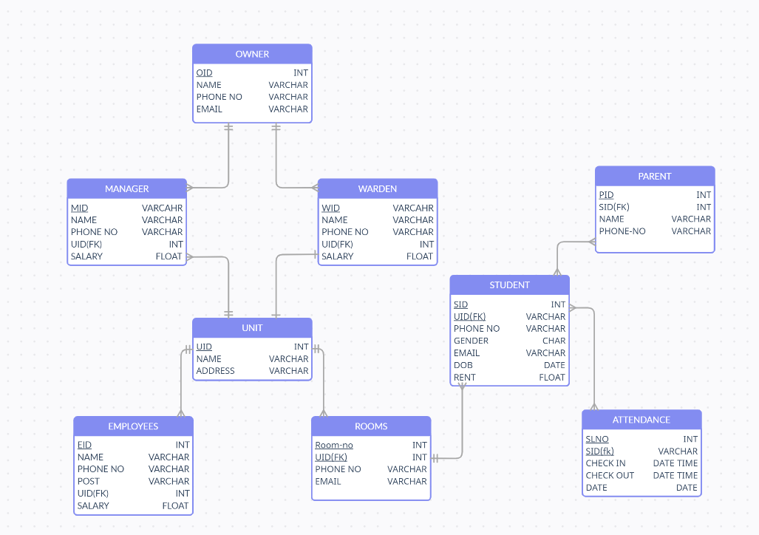
SCHEMA DIAGRAM:

Slide 20
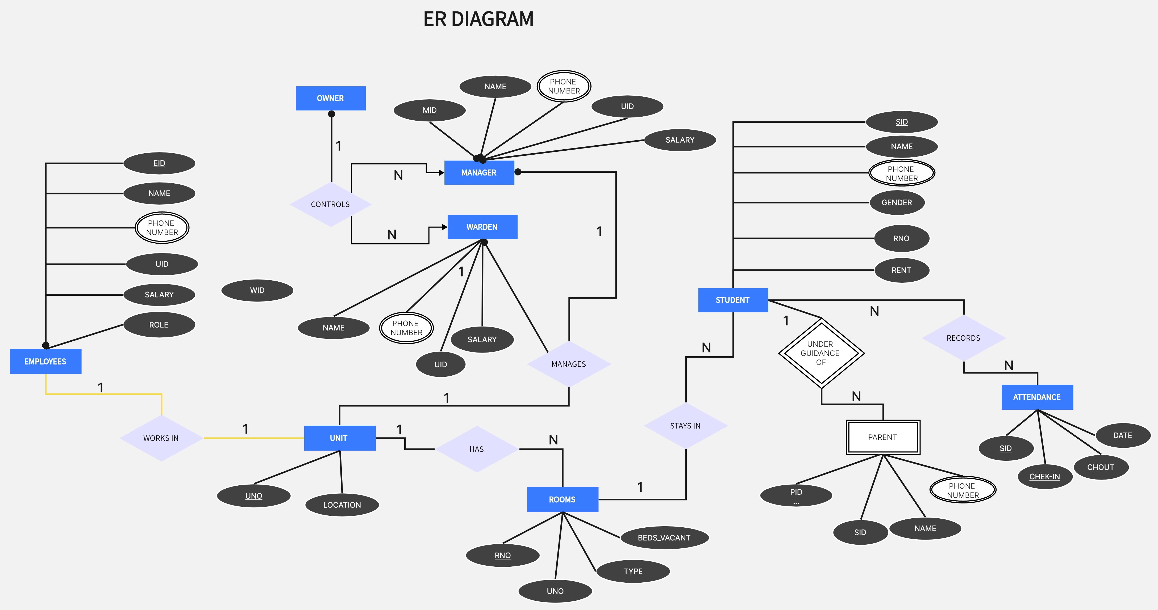
ER DIAGRAM:

Slide 21
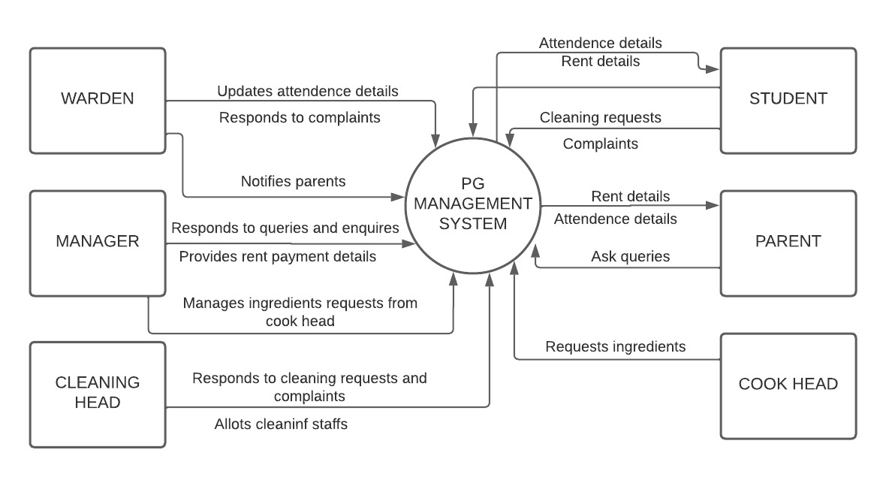
DFD DIAGRAM LEVEL 0:
21

Slide 22
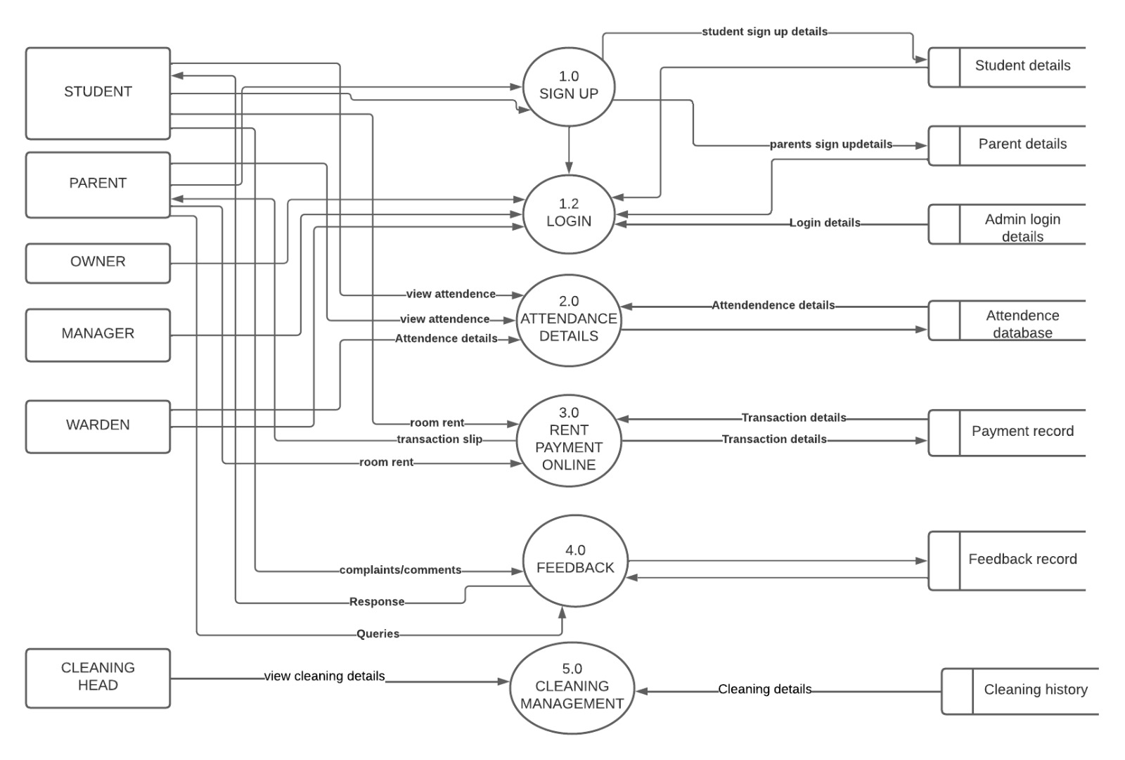
DFD DIAGRAM LEVEL 1:
22
22

Slide 23
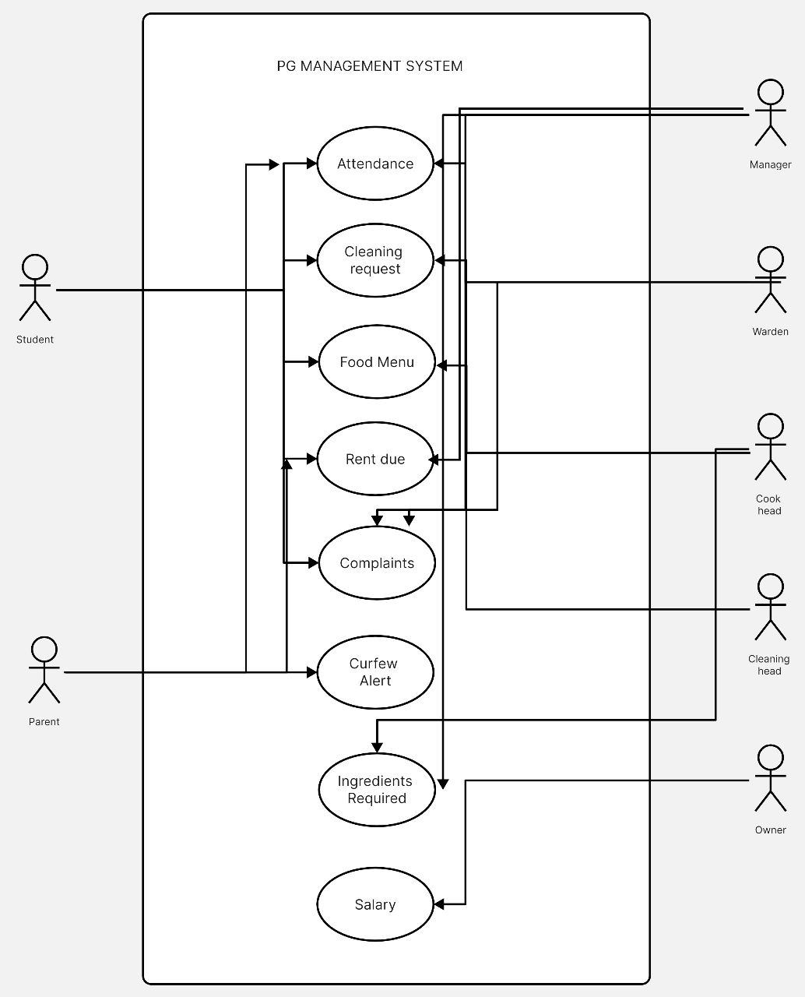
UML DIAGRAM:

Slide 24
THANK YOU!!

